Slide 1

PHP Assignment
RAMKUMAR S
Github :
https://github.com/Ramhardik88
while(!(succeed= try()));

Slide 2

Email a random XKCD challenge

Slide 3
Problem Statement
Your app should include email verification to avoid people using others’ email addresses.
XKCD image should go as an email attachment as well as inline image content.
You can visit https://c.xkcd.com/random/comic/ programmatically to return a random comic URL and then use JSON API for details https://xkcd.com/json.html
Please make sure your emails contain an unsubscribe link so a user can stop getting emails.

Slide 4


Slide 5

https://xkcd.com/json.html
API CALLS
Email verification
XKCD image
Email attachment
Inline image content
unsubscribe link
in email

Slide 6
Architecture diagram
An architectural diagram is a diagram of a system that is used to abstract the overall outline of the software system and the relationships, constraints, and boundaries between components.
https://lucid.app/lucidchart/invitations/accept/inv_b0c56b88-e0d2-4cb8-8f44-7ad7a184d50f

Slide 7
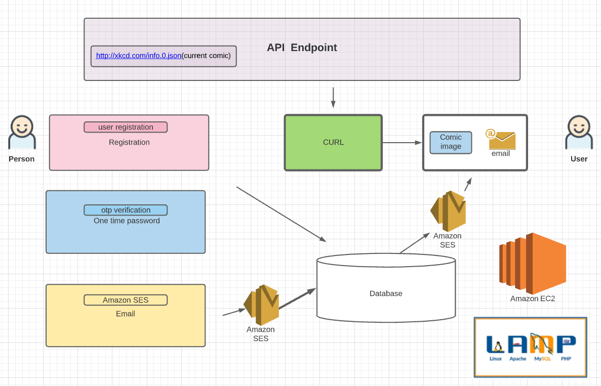

Slide 8
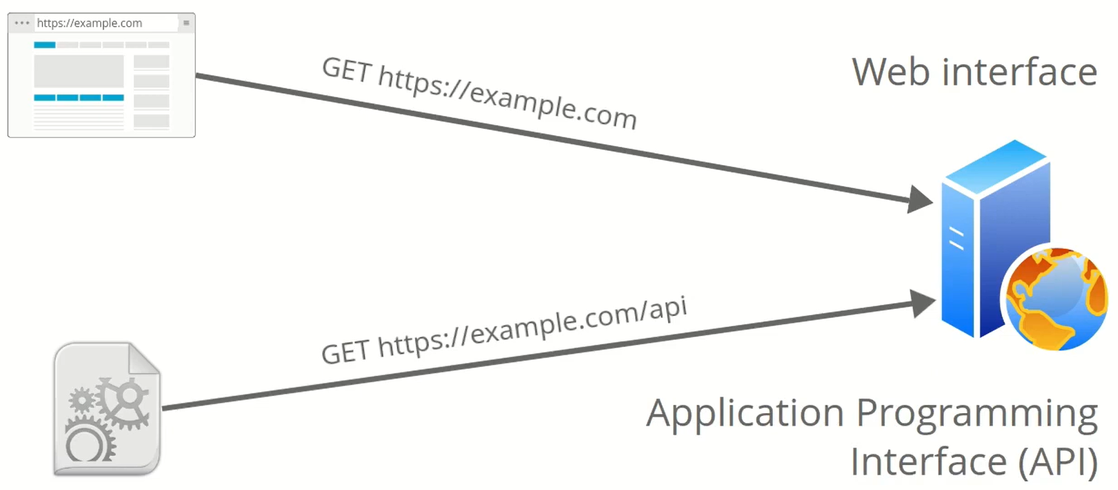
API

Slide 9
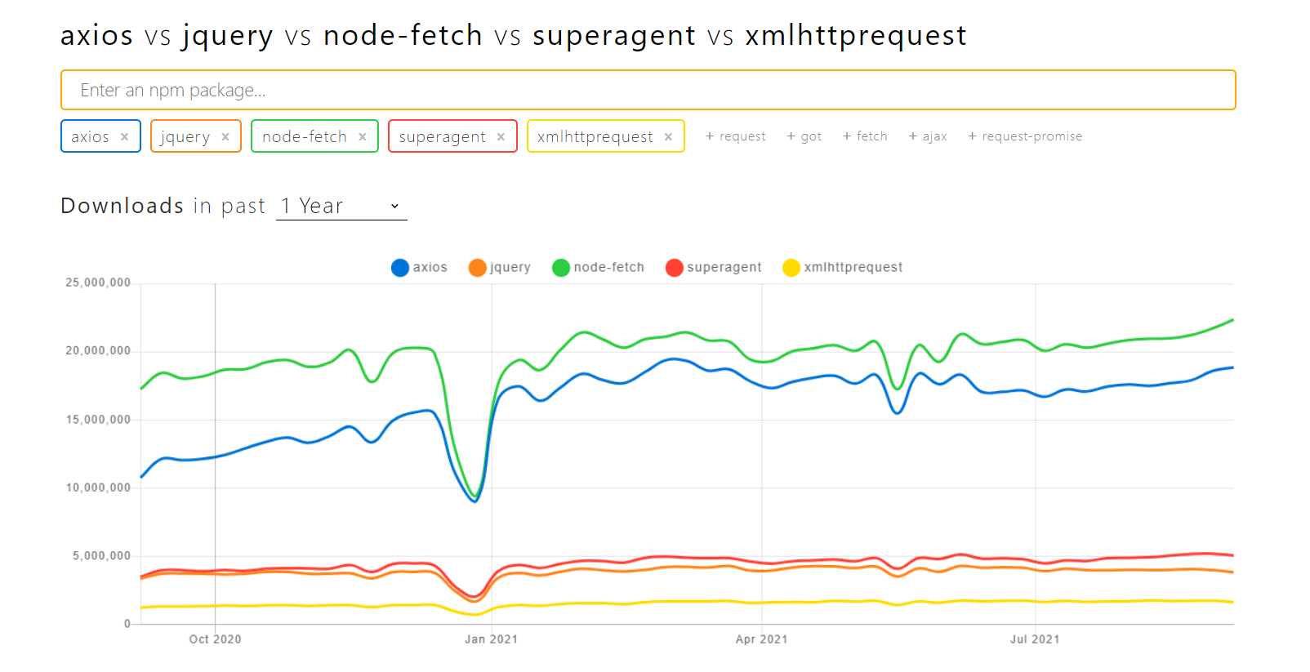

Slide 10
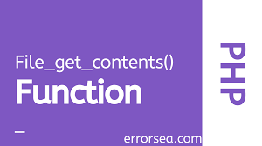



4 ways

Slide 11
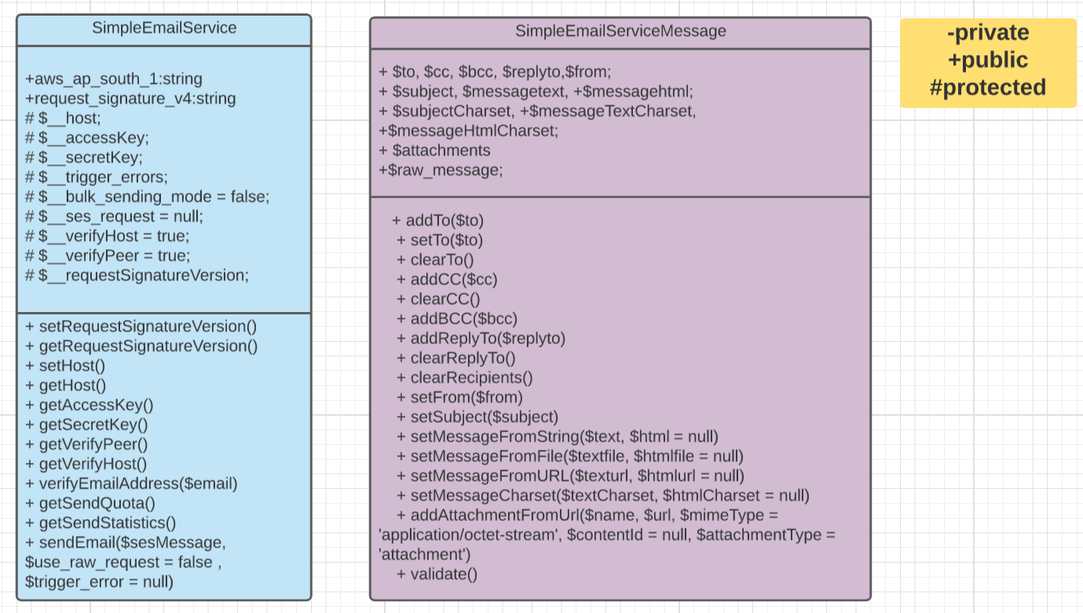
Aws-ses class diagram

Slide 12
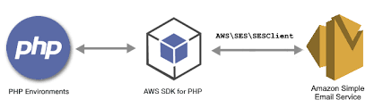
AWS SES
Amazon Simple Email Service (SES) is a cost-effective, flexible, and scalable email service that enables developers to send mail from within any application.

Slide 13
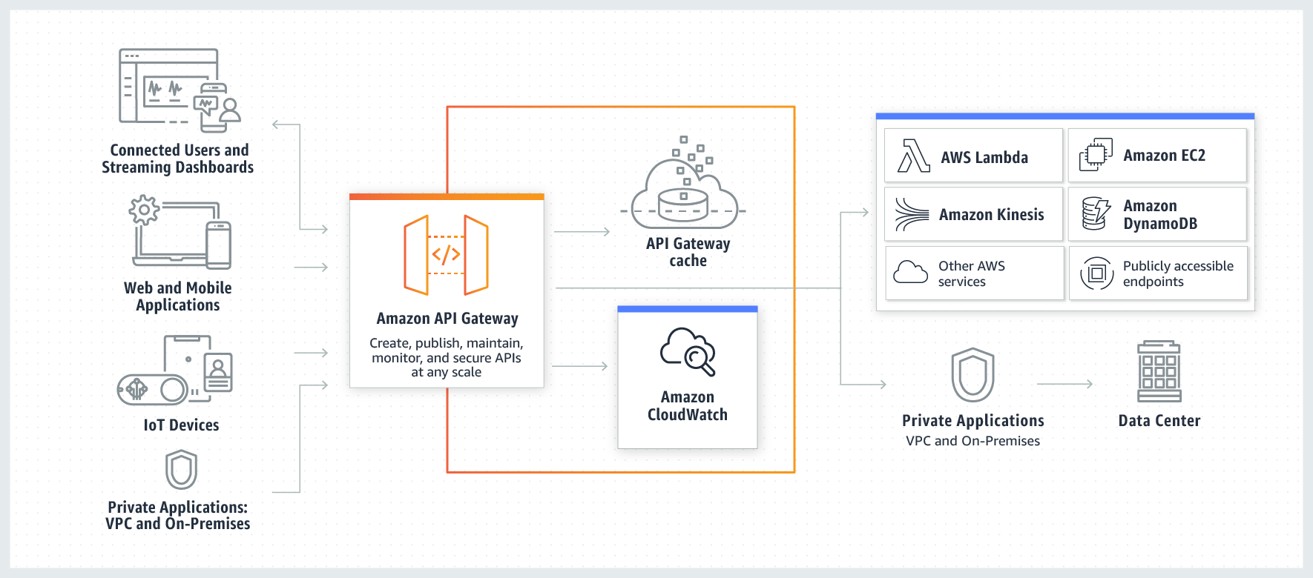

Slide 14
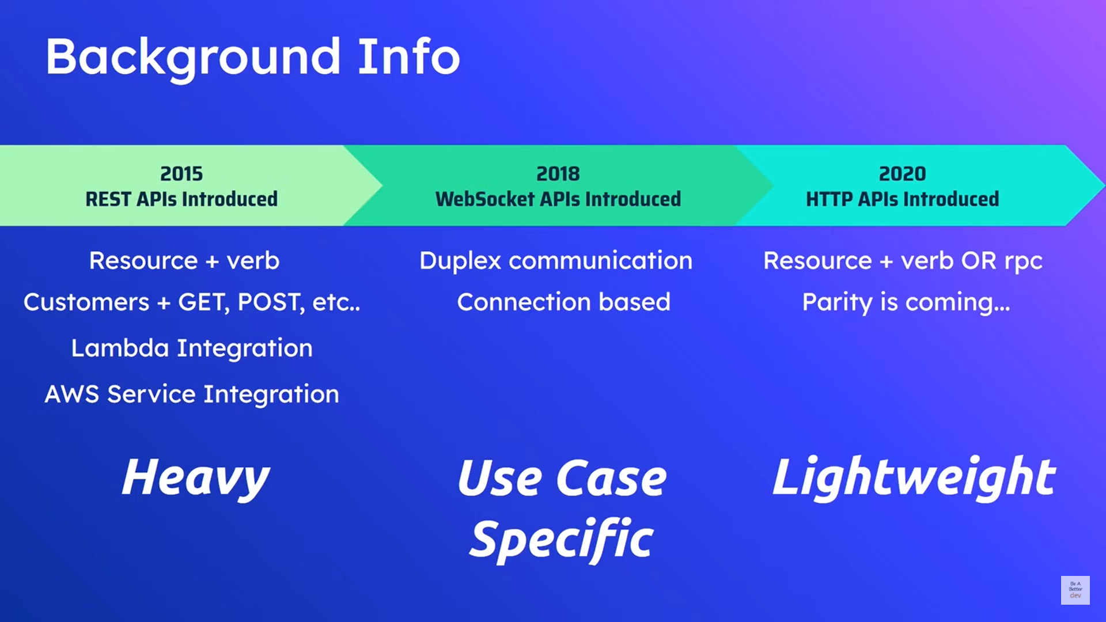

Slide 15
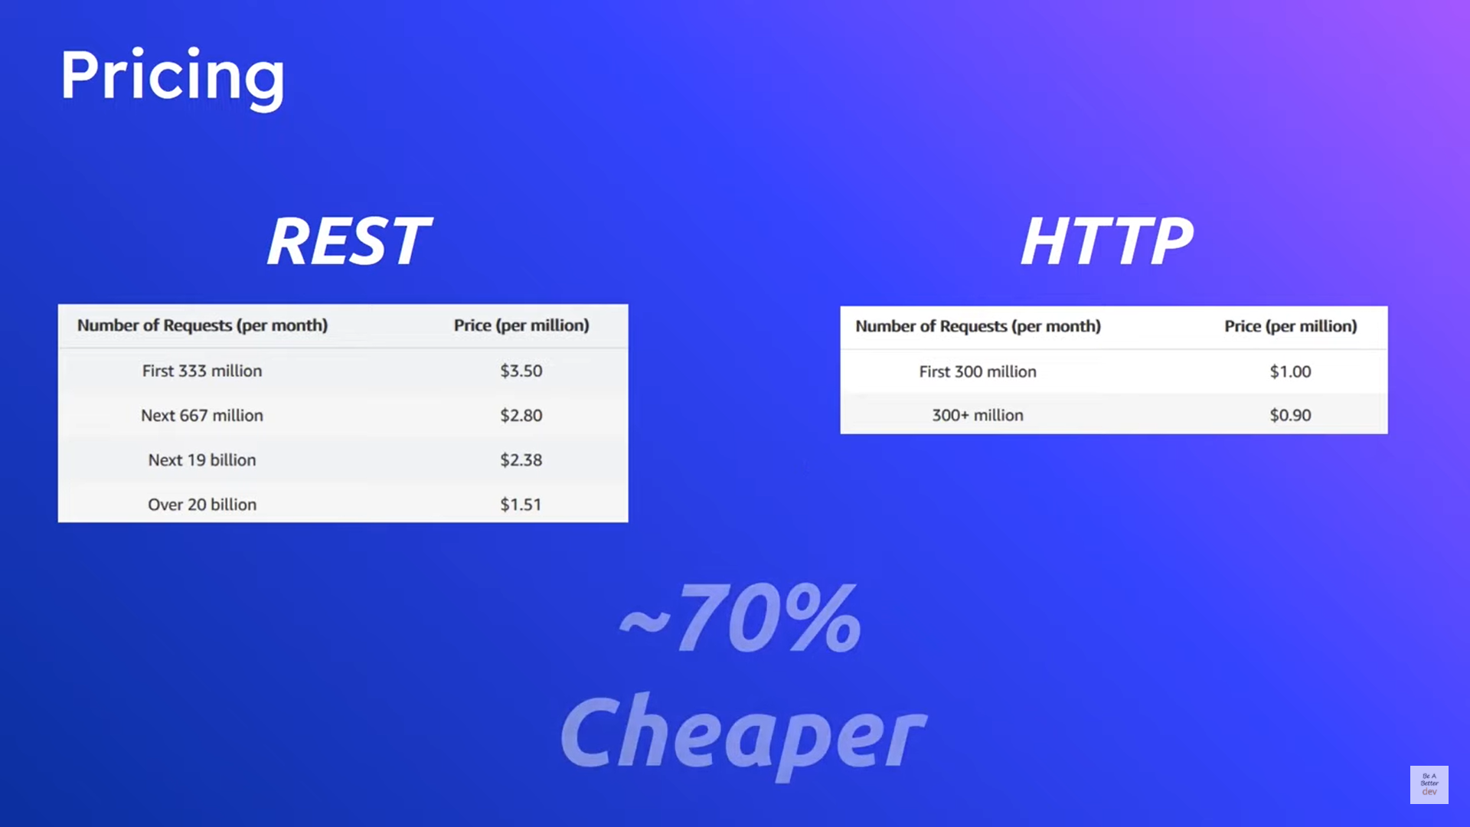

Slide 16


Slide 17
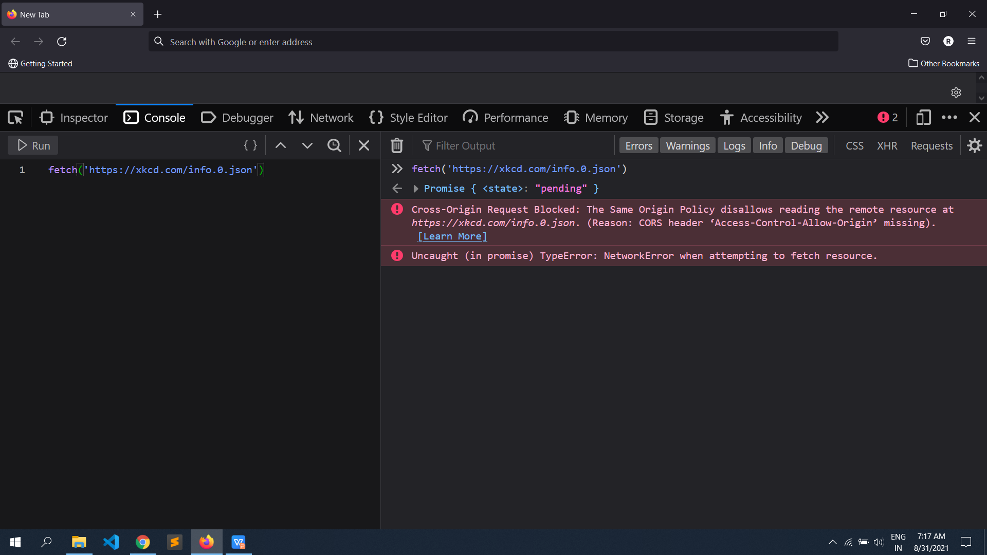
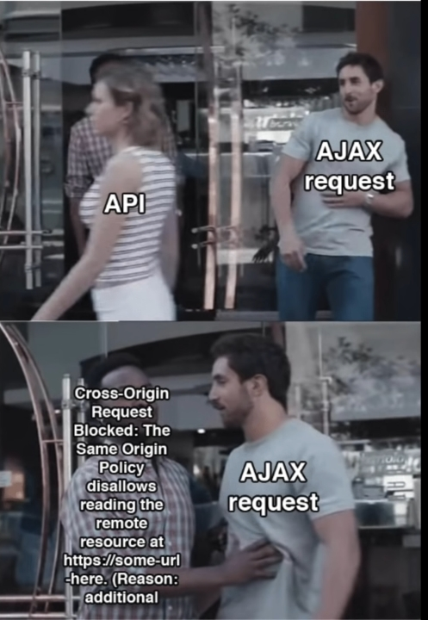

Slide 18

client URL

Slide 19
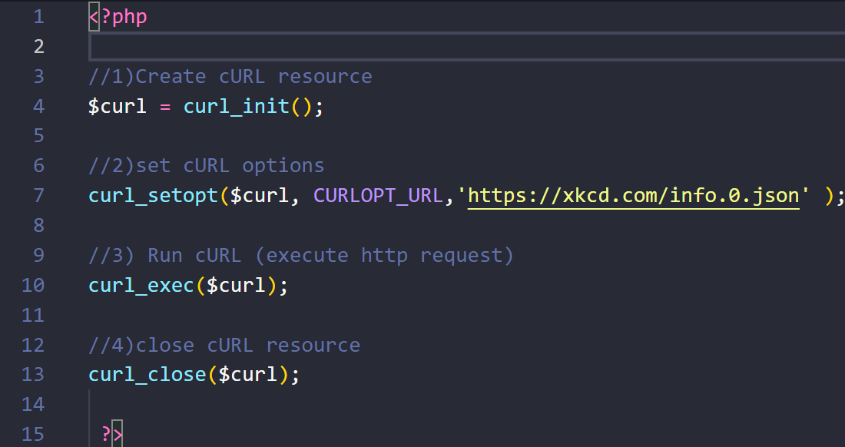
CURL is a library that lets you make HTTP requests in php

Slide 20
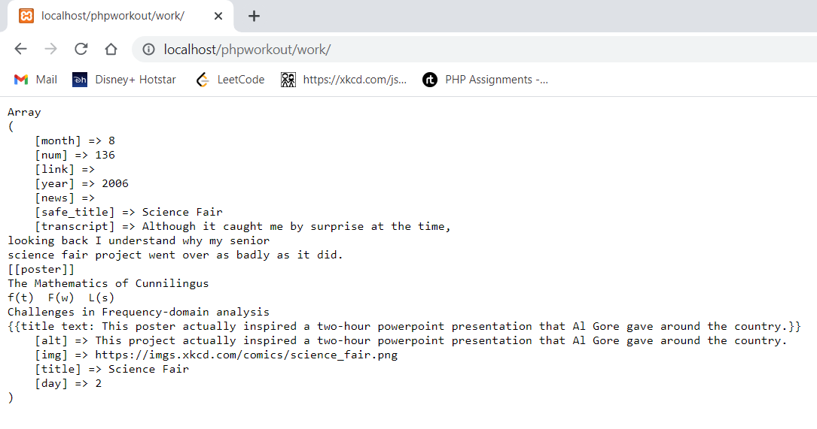
$decoded = json_decode($resp, true);
json_decode() used to decode a JSON string. It converts a JSON encoded string into object
If it is true then objects returned will be converted into associative arrays.

Slide 21
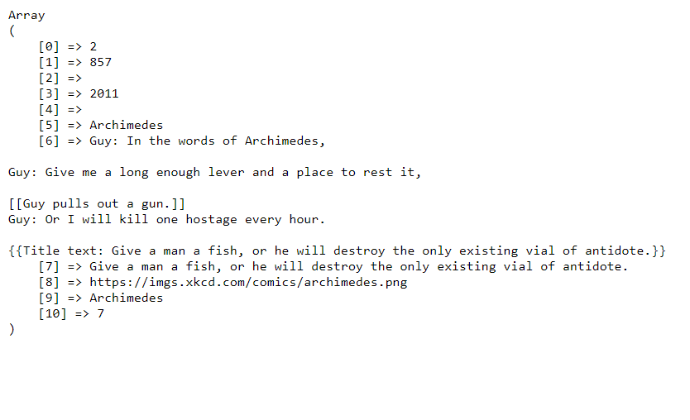
$decoded = array_values($decoded);
array_values() The returned array will have numeric keys, starting at 0 and increase by 1.

Slide 22
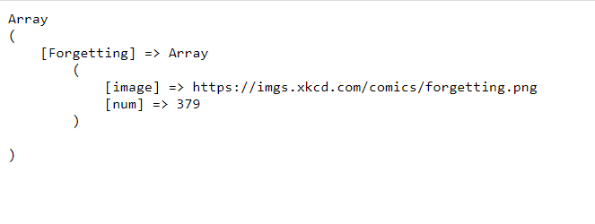
$comics = array();
$comic_name = ucwords($decoded[9]);
$comics[$comic_name]['image'] = $decoded[8];
$comics[$comic_name]['num'] = $decoded[1];

Slide 23






TECHNOLOGY USED

Slide 24


Slide 25


Slide 26
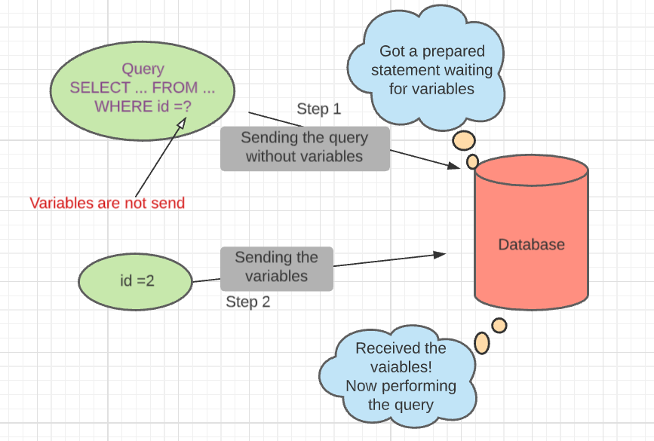
Prepared statement

Slide 27
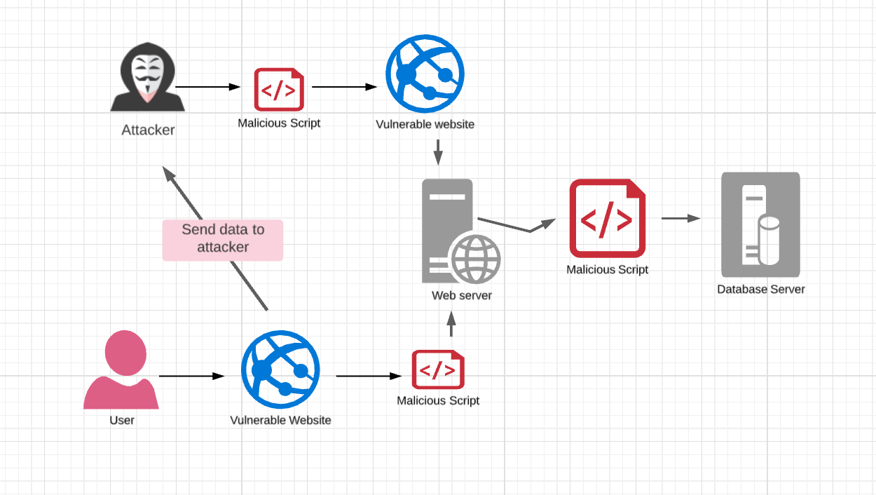
Cross-Site Scripting

Slide 28
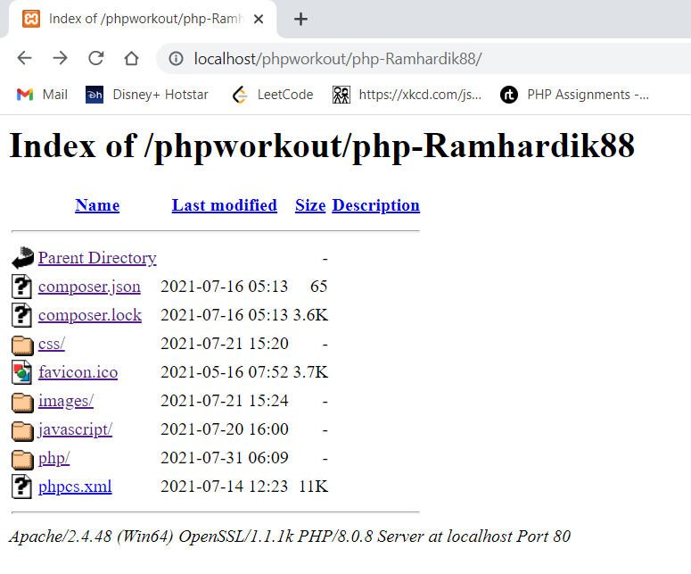
Directory browsing
Directory browsing is when you access a website using a web browser and instead of a webpage, you see a list of files and folders

Slide 29

Cron
The syntax is based on the Linux cron daemon definition.
* * * * * *
- - - - - -
| | | | | |
| | | | | + year [optional]
| | | | +----- day of week (0 - 7) (Sunday=0 or 7)
| | | +---------- month (1 - 12)
| | +--------------- day of month (1 - 31)
| +-------------------- hour (0 - 23)
+------------------------- min (0 - 59)

Slide 30
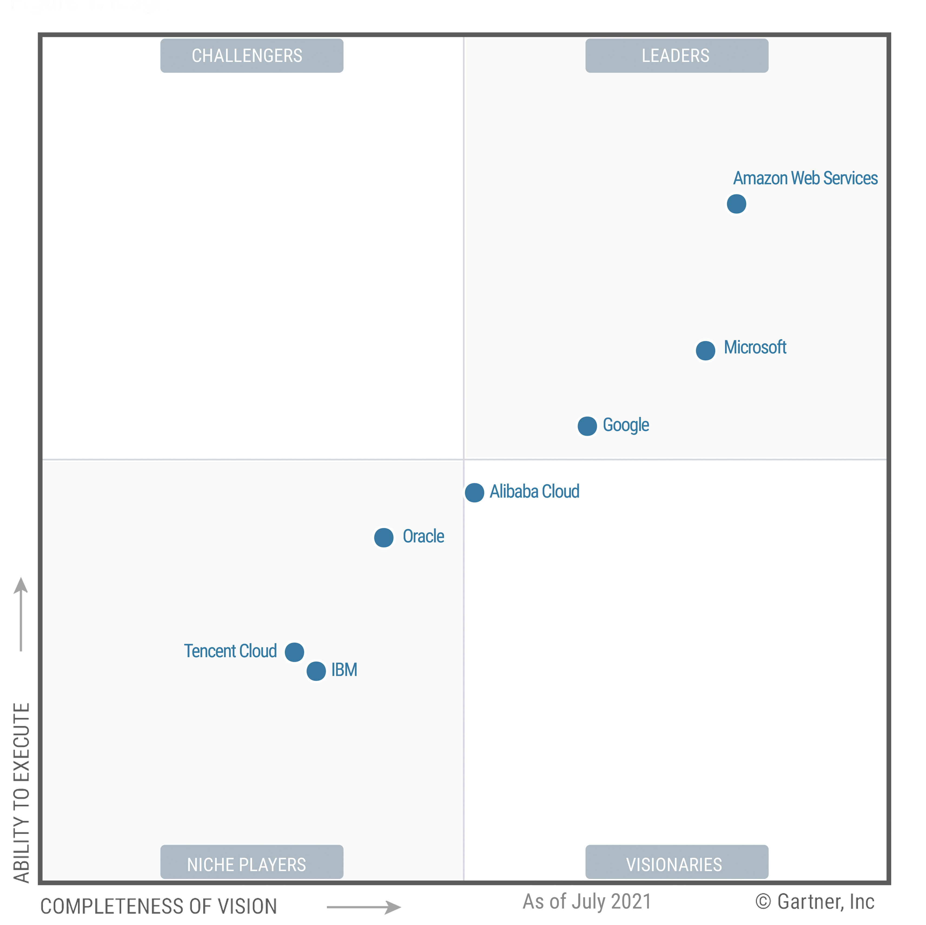



Slide 31
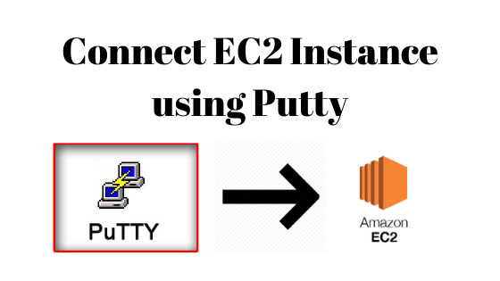
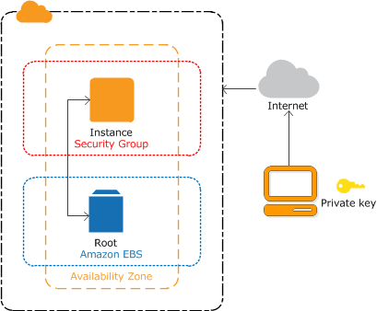

Slide 32
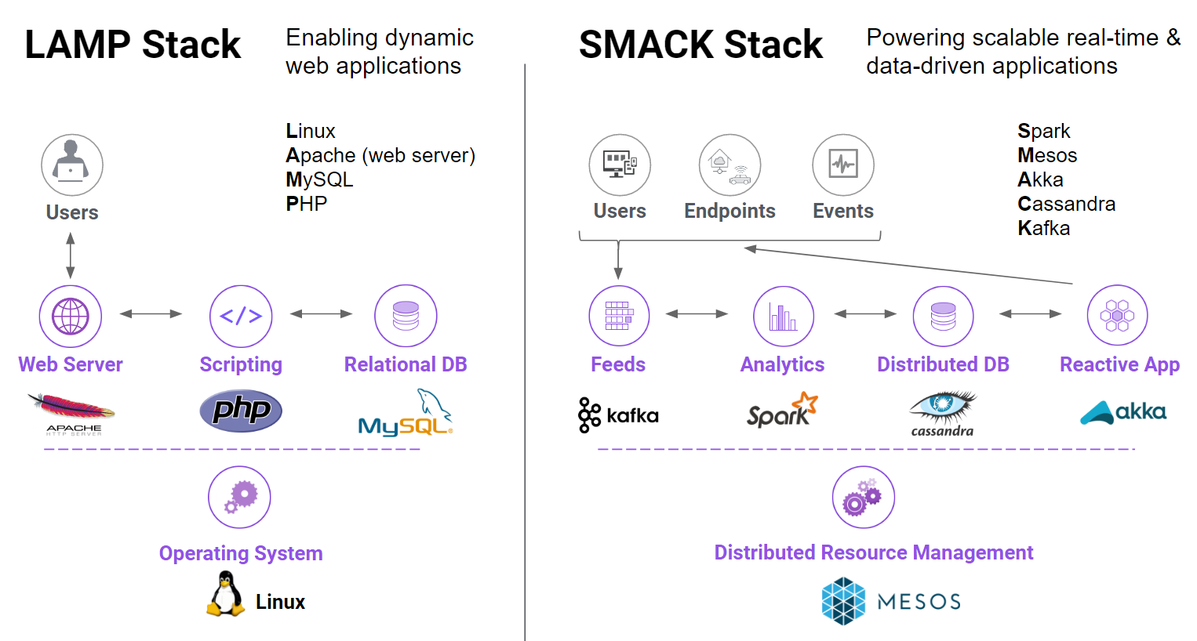

Slide 33
INSTALL LAMP STACK ON AWS - UBUNTU 18
Step 1 — Installing Apache
sudo apt update
sudo apt upgrade
sudo apt install apache2
Step 2 — Installing MySQL
sudo apt install mysql-server
sudo mysql_secure_installation
sudo mysql
Step 3 — Installing PHP
sudo apt install php libapache2-mod-php php-mysql
Step 4 — Installing phpMyAdmin
sudo apt update
sudo apt install phpmyadmin php-mbstring php-gettext

Slide 34

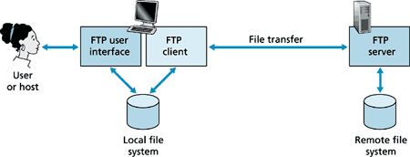

Slide 35
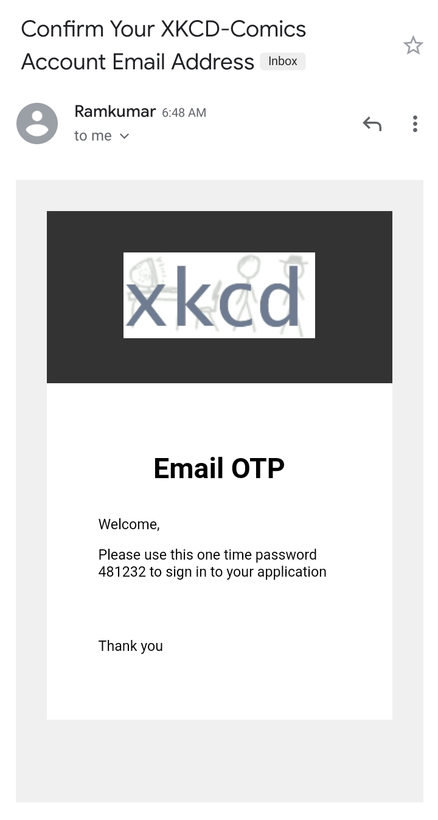
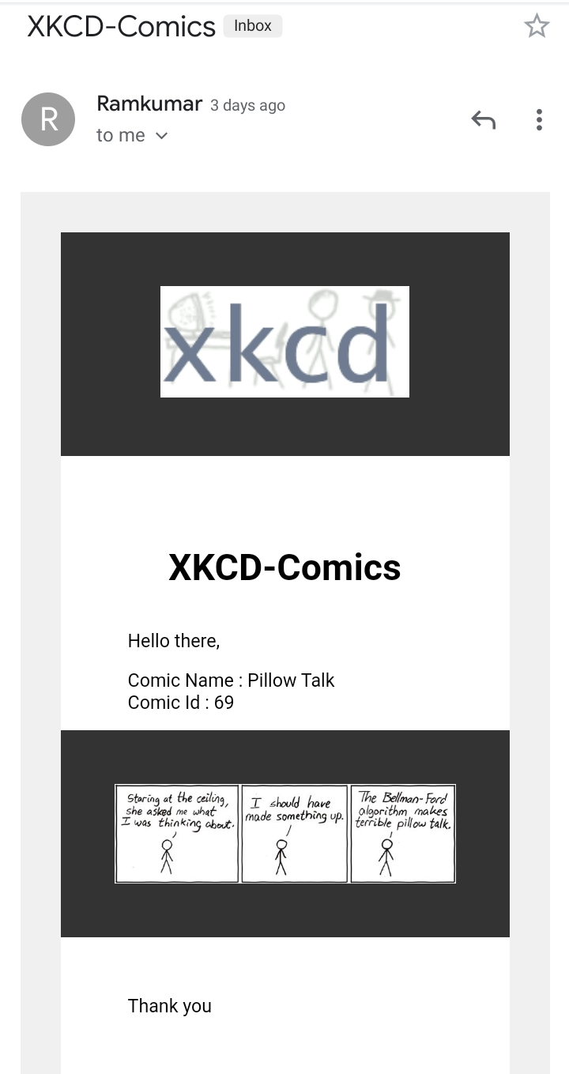
Output

Slide 36
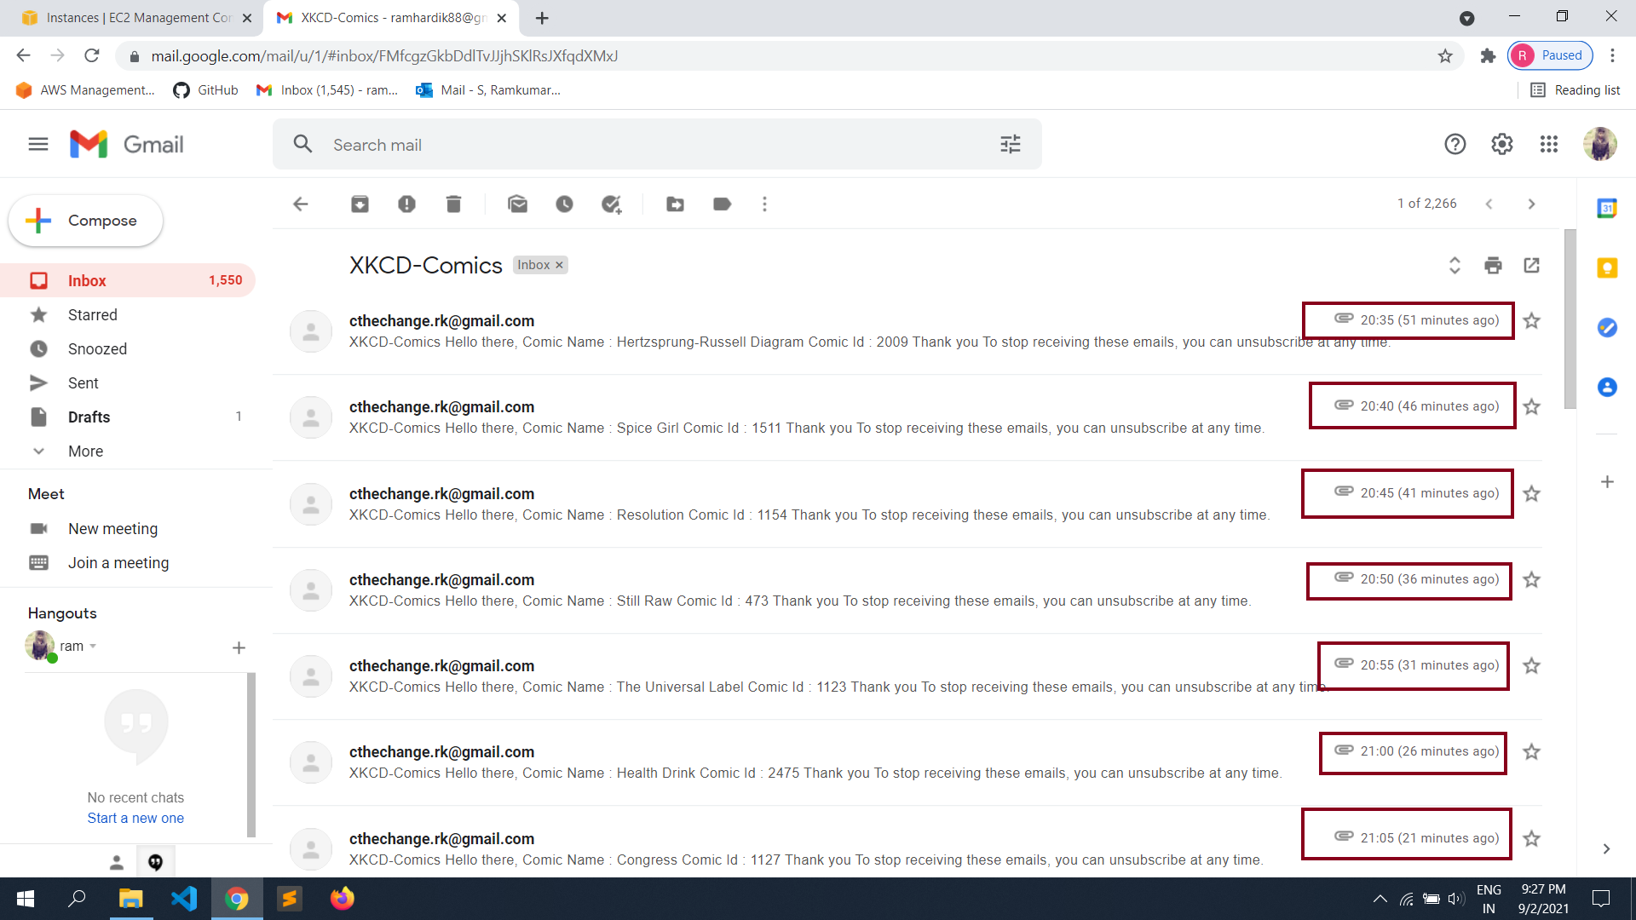

Slide 37


